Slide 1
Spring Wheat Yield Production
Nirali Kotak
Mentor : Ruhid Mirzayev

Slide 2
Overview
Introduction
Problem Statement - Predict Spring Wheat Yield
Data Collection and Preprocessing
Methodology
Time Series Analysis
K-means Clustering algorithm

Slide 3
Introduction
Agriculture sector has always been at the core of life and it requires years of experience to plan a season of farming along with optimizing the soil nutrition, water usage, crop yield, profits and make it sustainable
Historical data can help improve the optimization with a better accuracy and can help farmers to plan and strategize more effectively
This project provides insights into Spring Wheat yield prediction based on the historical data provided by Government of Saskatchewan from the year 1938

Slide 4
Data Collection and Preprocessing
Data cleaning is a very crucial step in Data Science and Analysis. The models and algorithms for predictions vary widely on how data cleaning is performed
Data cleaning includes identifying and fixing of:
Missing values like NaN or null
Incorrect values or outliers
Incorrectly formatted
Corrupted values
Incomplete data

Slide 5
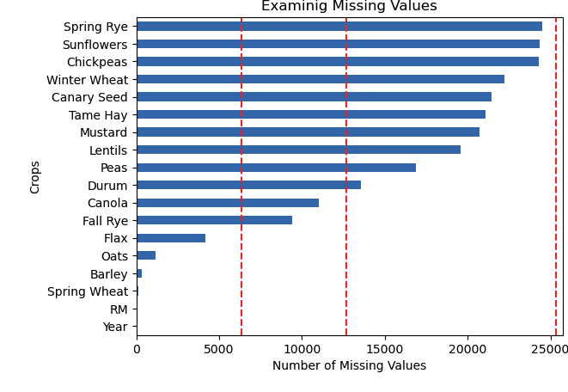
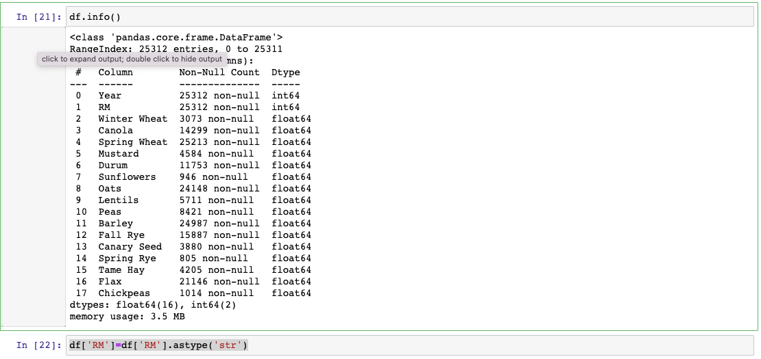
Data Collection and Preprocessing
Ensure data collected yearly is not duplicated
Format the columns datatype
Missing Values

Slide 6
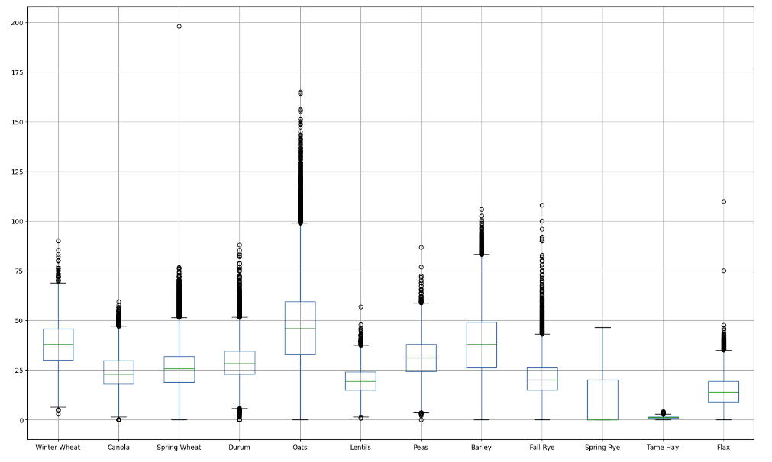
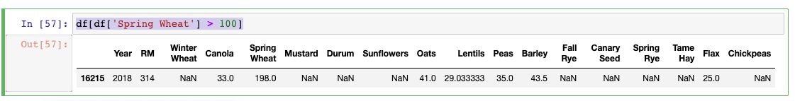
Data Collection and Preprocessing
Identify Outliers

Slide 7
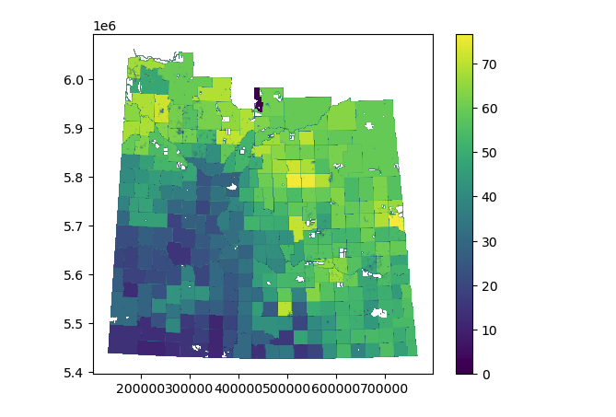
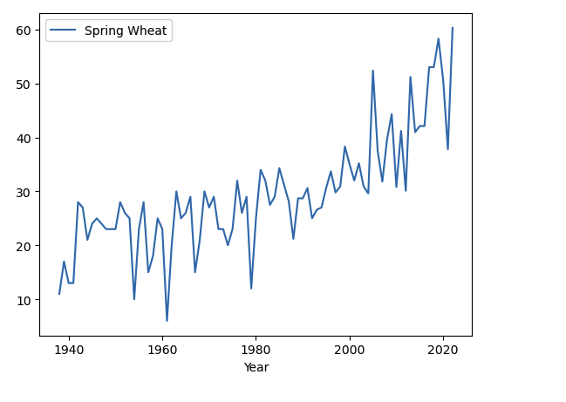
Spring Wheat Yield

Slide 8
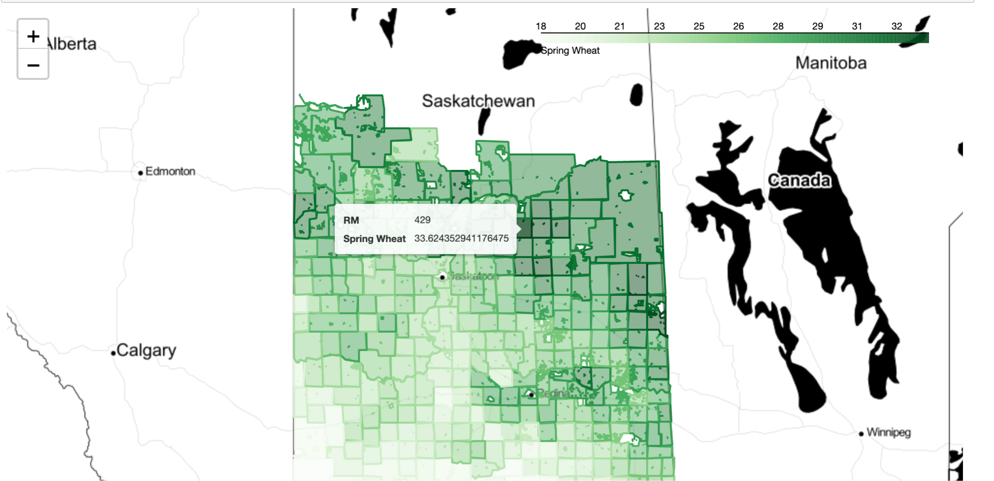
Spring Wheat per RM

Slide 9
Methodology
Time Series Analysis
A time series is a sequence of data points that occur in successive order over some period of time
Auto-Regressive Model
ARIMA
XGBoost

Slide 10
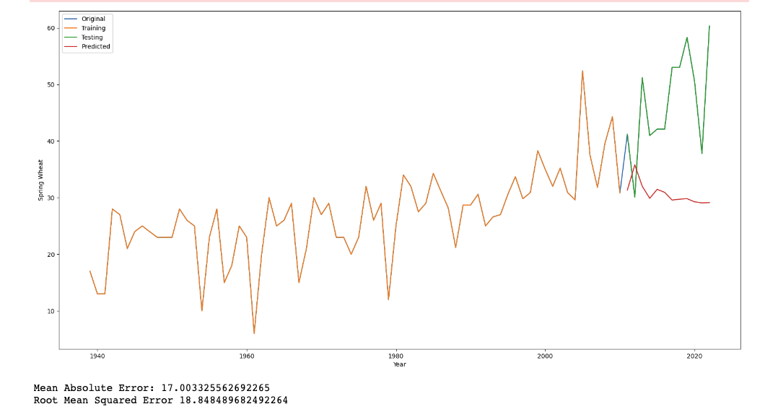
Methodology
Time Series Analysis - AR
AR(p) is a simple but powerful model that assumes the value of a variable at a given time point depends linearly on its past values. In other words, it assumes that the current value of a variable can be predicted based on its own previous values.
X(t) = c + φ₁X(t-1) + φ₂X(t-2) + ... + φₚX(t-p) + ε(t)
X(t): the variable of interest at time t
c: constant term
φ₁, φ₂, ..., φₚ are the autoregressive coefficients
X(t-1), X(t-2), ..., X(t-p): lagged values
ε(t): random error term.

Slide 11
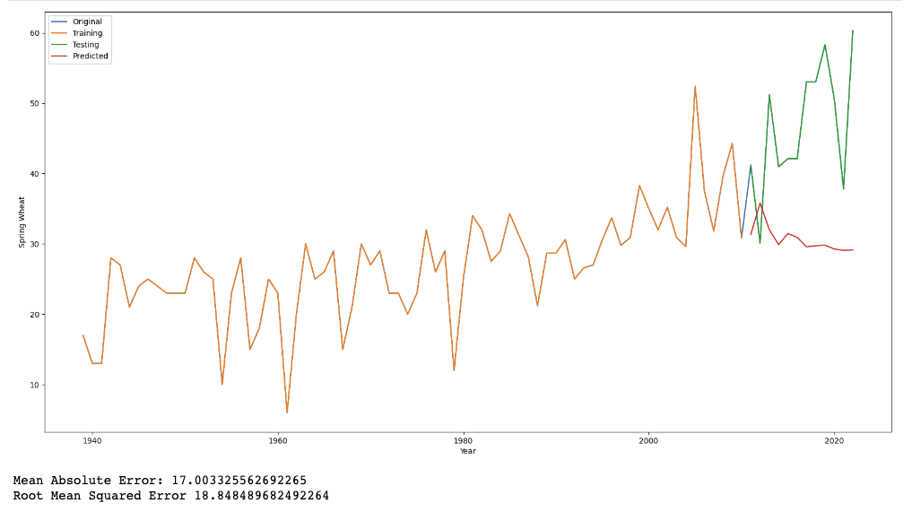
Methodology
Time Series Analysis - ARIMA
ARIMA(p,d,q) is a popular and widely used model for time series forecasting and analysis. Three main components:
Autoregressive (p) - correlation current time value and historical lagged values
Integrated (d) - differencing values to make it stationary
Moving Average (q) - The moving average component represents the relationship between an observation in the time series and the residual errors from a moving average model applied to lagged observations. It captures random noise and shocks in data

Slide 12
Methodology
Time Series Analysis - XGBoost
XGBoost can be applied to time series analysis by transforming the problem into a supervised learning task. The basic idea is to use lagged observations of the target variable and other relevant features as input to predict the target variable at a future time step. This transformation enables XGBoost to leverage its ability to capture complex relationships and make accurate predictions.
Here are the general steps involved in applying XGBoost to time series analysis:
Data Preparation: Arrange the time series data in a tabular format with columns representing lagged observations and features. The target variable should be shifted to represent future values.
Feature Engineering: Create relevant lagged features, such as lagged values of the target variable and other variables that may have predictive power. Additionally, you can incorporate time-based features like day of the week or month.
Train-Test Split: Divide the dataset into training and testing sets, ensuring that the order of observations is preserved. Typically, the more recent data is kept for testing to evaluate the model's performance on unseen data.
XGBoost Modeling: Build an XGBoost model using the training data. Specify the appropriate objective function, hyperparameters, and performance metrics based on your specific time series problem.
Model Training: Train the XGBoost model on the training set, optimizing the objective function and minimizing the chosen loss function.
Model Evaluation: Evaluate the trained model on the test set using appropriate evaluation metrics for time series forecasting, such as mean absolute error (MAE) or root mean squared error (RMSE).
Model Fine-tuning: Experiment with different hyperparameter values, feature selection techniques, or model architectures to improve performance. Techniques like cross-validation can be applied for hyperparameter tuning.
Forecasting: Once the model is trained and validated, you can use it to make predictions on unseen data or forecast future values of the time series.

Slide 13
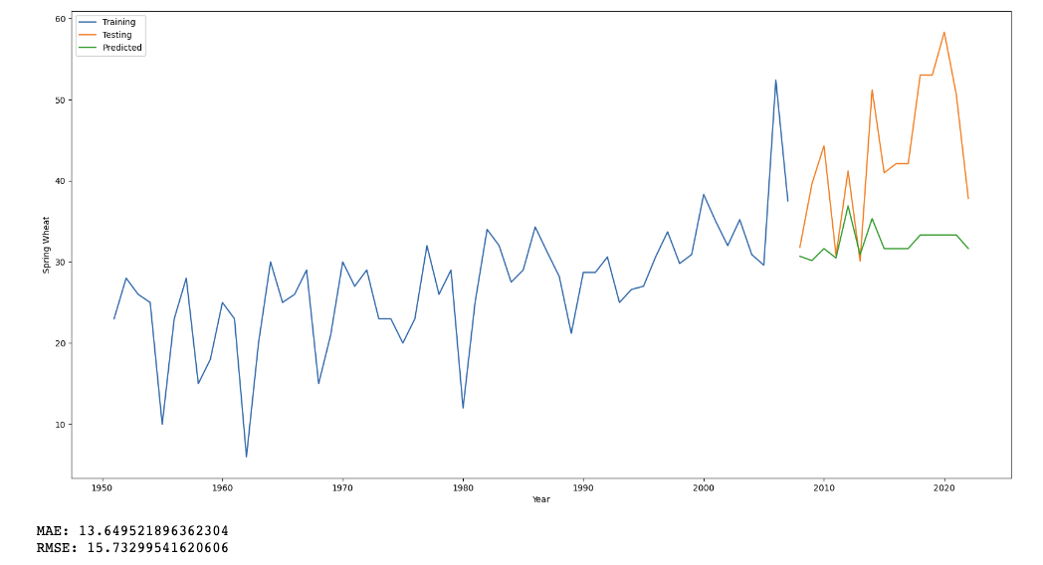
Methodology
Time Series Analysis
XGBoost

Slide 14
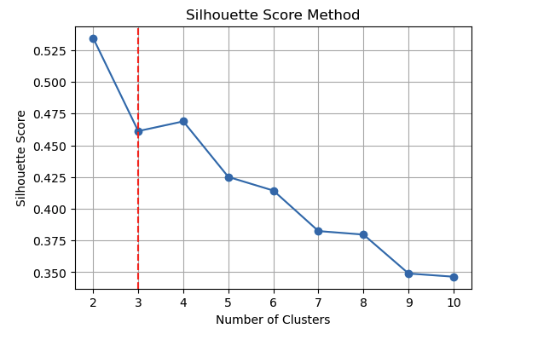
Methodology
K-means
Silhouette Score Method
Silhouette Coefficient or silhouette score is a metric used to calculate the goodness of a clustering technique. Its value ranges from -1 to 1.
1: Means clusters are well apart from each other and clearly distinguished.
0: Means clusters are indifferent, or we can say that the distance between clusters is not significant.
-1: Means clusters are assigned in the wrong way.

Slide 15
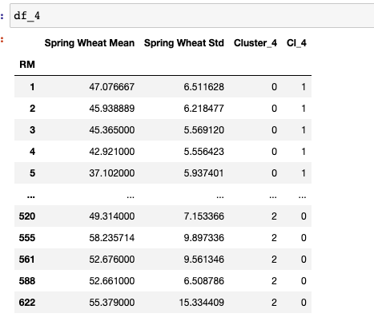
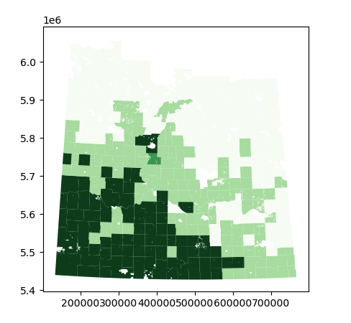
Methodology

Slide 16
Thank you

